Slide 1
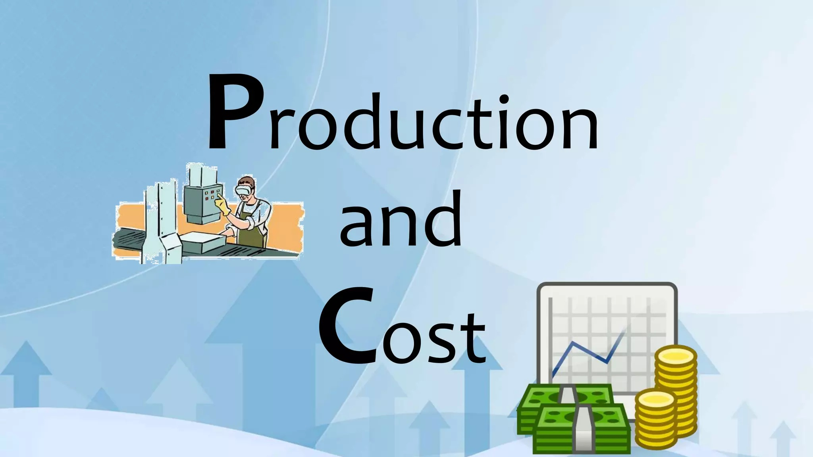
Notes:
Introduce students to production and cost analysis. Emphasize its role in managerial decision making regarding output levels, pricing, investment and planning.

Slide 2
Concepts of production
Production function with one variable input - law of variable proportion,
Laws of returns to scale
Indifference curves
Iso-quants & iso-cost line
Economies of scale & diseconomies of scale.
Types of cost
Cost curves
Cost – output relationship in the short run and in the long run
Long- run average cost ( lac)curve
Break even analysis–meaning, assumptions, determination of BEA, limitations, margin of safety, uses of BEA in managerial decisions

Slide 3
Production
Production refers to the process of converting inputs into outputs (goods or services) that satisfy human wants. Production implies provision of goods and services, often described as ‘commodities’. It is the act of converting or transforming input into output.
A production function refers to the functional relationship, under the given technology, between physical rates of input and output of a firm, per unit of time.
According to the Stigler(1966), “the production function is the name given to the relationship between rates of input of productive services and the rate of output of product. It is the economist’s summary of technical knowledge”
Notes:
Explain that production is not restricted to making goods. Any activity that adds value is production, like banking or transport. Clarify short-run and long-run meaning.

Slide 4
In algebraic terms, the production function may be written as:
Q = f(a, b, c, d, … , n, T–) OR Q=f(L,K)
Q represents the physical quantity of output (commodity produced) per unit of time.
F denotes functional relationship.
a, b, c, d, n represent the quantities of various inputs (productive factors) per employed time period.
T– refers to the prevailing state of technology or ‘know-how.’
The bar (–) is placed on t– just to indicate that technology is assumed to be constant.
L refers to the Labour
K refers to the Capital

Slide 5
Q = f(l, K̄)
Where K̄ refers the fixed level of capital. This means that the firm can only increase output by increasing the amount of labor employed, given the existing capital stock.
Total product (TP): Total product (TP) refers to the total quantity of output produced by a firm with a given amount of labor, holding other inputs constant. As the amount of labor increases, the total product will generally increase, but not necessarily at a constant rate.
Average product (AP): Average product (AP) measures the output produced per unit of labor. It is calculated as:
Ap = TP / L
The average product provides insights into the productivity of each worker on average.

Slide 6
Marginal product (MP): Marginal product (MP) measures the change in total product resulting from a one-unit change in labor input, holding other inputs constant. It is calculated as:
MP = Change in TP / Change in Labour
The marginal product is crucial for understanding the incremental contribution of each additional worker to the total output

Slide 7
Law of Variable Proportion
This is the modern version of the law of diminishing marginal returns. Under this law, it is assumed that only one factor of production is variable while other factors are fixed. As we increase the quantity of variable factor while keeping other factors constant, the output of variable factor may increase more than proportionately in the initial stages of production but finally it will not increase proportionately.
Prof. Benham states the law as follows: “As the proportion of one factor in a combination of factors is increased after a point, the average and marginal production of that factor will diminish.”
Only one factor is varied and all other factors should remain constant.
The scale of output is unchanged, and the production plant or the size efficiency of the firm remain constant.
The technique of production does not change.

Slide 8
There are mainly 3 stages in this law.
Stage I: Increasing Returns: In the first stage, as more units of the variable input (labor) are employed, the total product (TP) increases at an increasing rate. This means that each additional unit of labor contributes more to the total output than the previous unit.
Stage II: Diminishing Returns (rational stage): In the second stage, as more units of the variable input (labor) are employed, the total product (TP) continues to increase, but at a decreasing rate. This means that each additional unit of labor contributes less to the total output than the previous unit.
Stage III: Negative Returns: In the third stage, as more units of the variable input (labor) are employed, the total product (TP) starts to decline. This means that each additional unit of labor actually reduces the total output.

Slide 9
Limitations of the Law
Fixed factors may not be truly fixed: In reality, it may be possible to vary the quantities of some of the fixed factors, even in the short run.
Homogeneity assumption may not hold: The units of the variable factor may not be perfectly homogeneous. Some units may be more efficient than others.
Technology may not remain constant: Technological advancements can shift the production function and alter the relationship between inputs and outputs.
Divisibility of factors: The law assumes that factors are perfectly divisible, which may not always be the case.

Slide 10
Laws of returns to scale
Economists use the phrase “returns to scale” to describe the output behaviour in the long-run in relation to the variations in factor inputs. In the short-run, thus, we have returns to variable factor. In the long-run, we have returns to scale. The long run production function Q = f(a1, b1, c1, ...n, T) implies that all components of inputs are varied to increase production.
“As a firm in the long run increases the quantities of all factors employed, other things being equal, the output may rise initially at a more rapid rate than the rate of increase in inputs, then output may increase in the same proportion of input, and ultimately, output increases less proportionately.”

Slide 11
There are three main types of returns to scale:
Increasing Returns to Scale: Output increases by a larger proportion than the increase in inputs. Marshall explains increasing returns in terms of ‘increased efficiency’ of labour and capital in the improved organization with the expanding scale of output and employment of factor input. It is referred to as ‘the economy of organization in the earlier stages of expansion.
Constant Returns to Scale: Output increases by the same proportion as the increase in inputs. According to Marshall, the law of constant returns tends to operate when the actions of the laws of increasing returns and decreasing returns are balanced out; or in other words, economies and diseconomies of scale are exactly in balance over a range of output.
Notes:
Explain using factory example where number of workers increases but machines remain fixed.

Slide 12
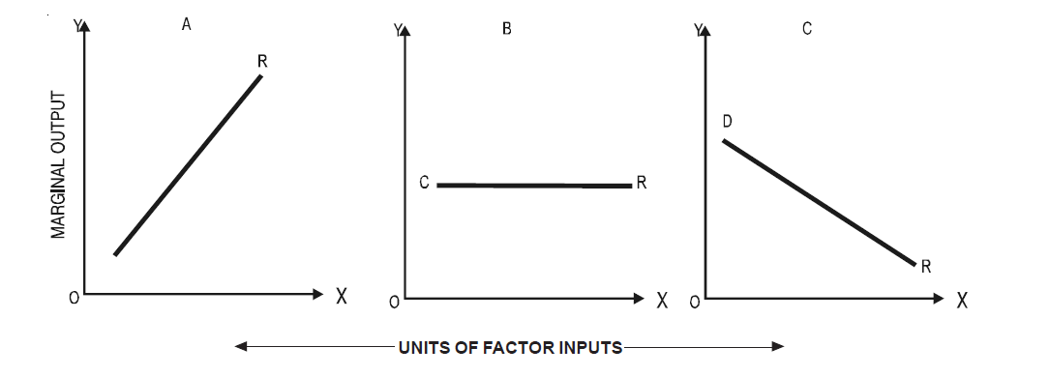
Decreasing Returns to Scale: Output increases by a smaller proportion than the increase in inputs. Decreasing returns to scale are usually attributed to increased problems of organization and complexities of large-scale management which may be physically very difficult to handle.

Slide 13
Factors Influencing Returns to Scale:
1. Managerial Efficiency: Efficient management improves coordination, supervision, and decision-making. As scale expands, if management becomes more specialized and organized then it is increasing returns to scale. If management becomes complex, communication delays arise then it is decreasing returns to scale.
2. Technical / Technological Factors: Advanced machines, automation, and better technology enhance productivity. Large-scale firms can adopt modern techniques not affordable to small firms.
3. Specialisation & Division of Labour: Larger scale allows each worker to specialize in specific tasks. Leads to skill improvement, faster production, and less wastage.
4. Availability & Efficient Use of Capital: Large firms access capital at lower costs. They can invest in better infrastructure and machinery and it will help to reduce per-unit cost.

Slide 14
5. Nature of the Production Process: Industries like software, electricity, steel benefit greatly from scaling up. Agricultural production often faces natural limits.
6. Indivisibility of Inputs: Some inputs (like big machines, R&D departments) cannot be used efficiently at small scale. When scale increases, these indivisible resources are fully utilized to get more output.
7. Coordination & Administrative Difficulties: At very large scale complexity rises. Coordination problems, bureaucracy, delays Decreasing Returns to Scale

Slide 15


Slide 16
An isoquant derived from "iso," meaning equal, and "quant," meaning quantity or product means output. Production function with two variable inputs or equal product curves.
According to Ferguson, “an isoquant is a curve showing all possible combinations of inputs physically capable of producing a given level of output.” It represent al those combinations of inputs which are capable of producing the same level of output.
PROPERTIES OF ISO-QUANT:
Iso-quants have a downward slope.
Iso-quants are convex to origin.
Iso-quants do not intersect
The iso-quant is an oval shape curve.

Slide 17
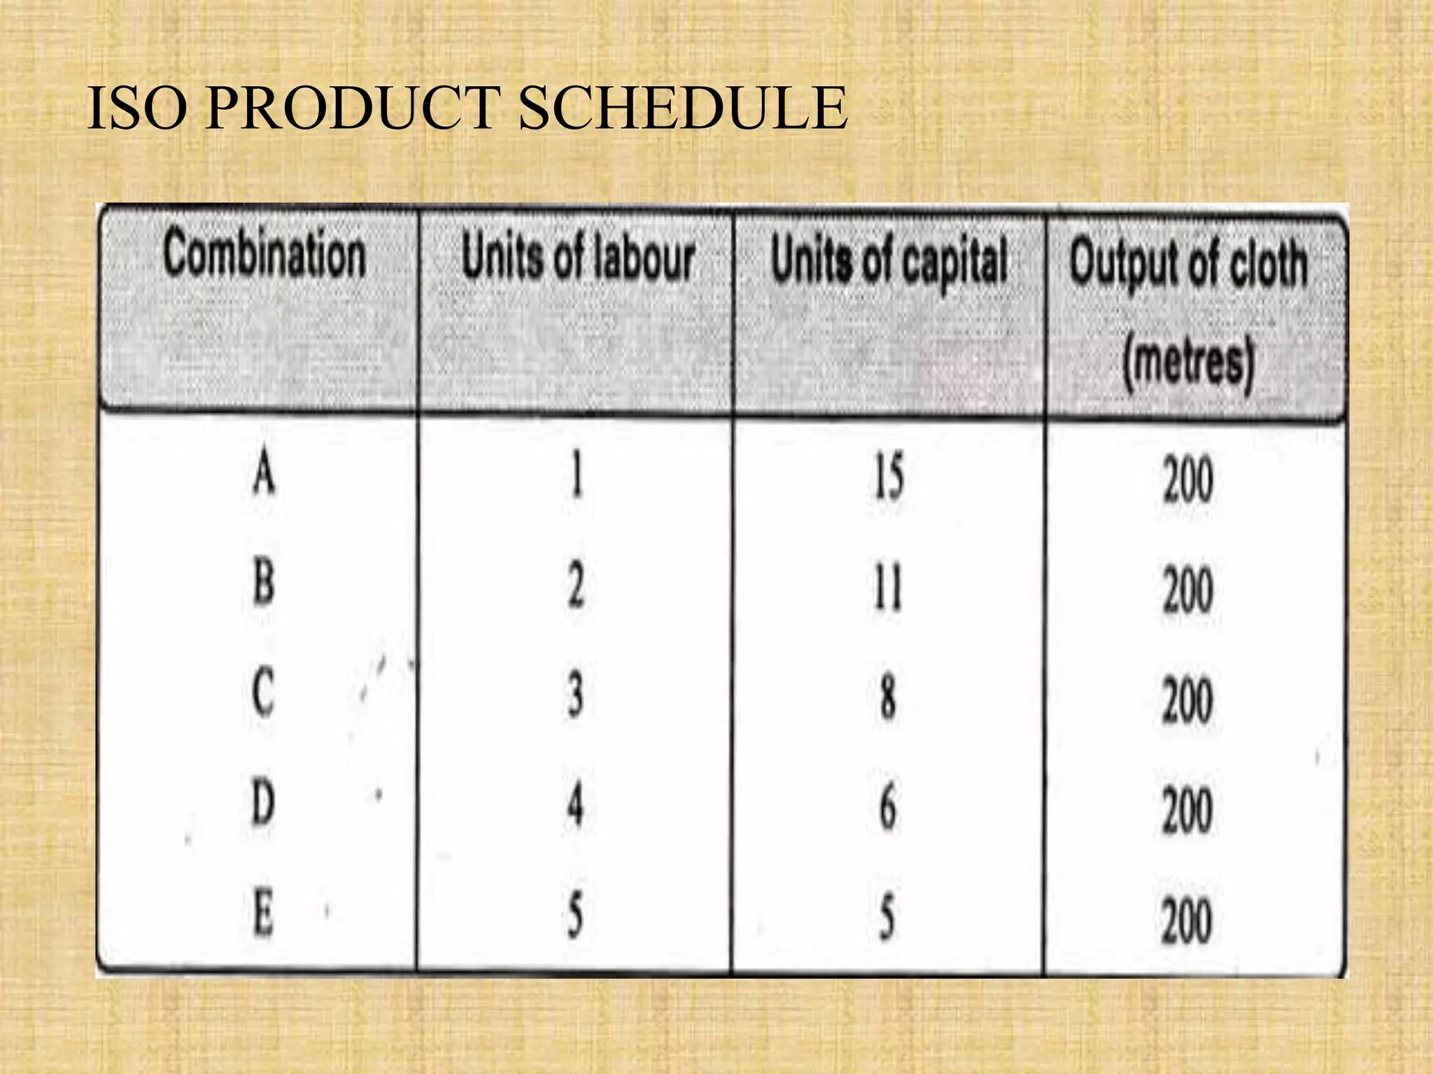
Notes:
Explain plant size fixed in short run; in long run firm can expand factory, increase capital etc.

Slide 18
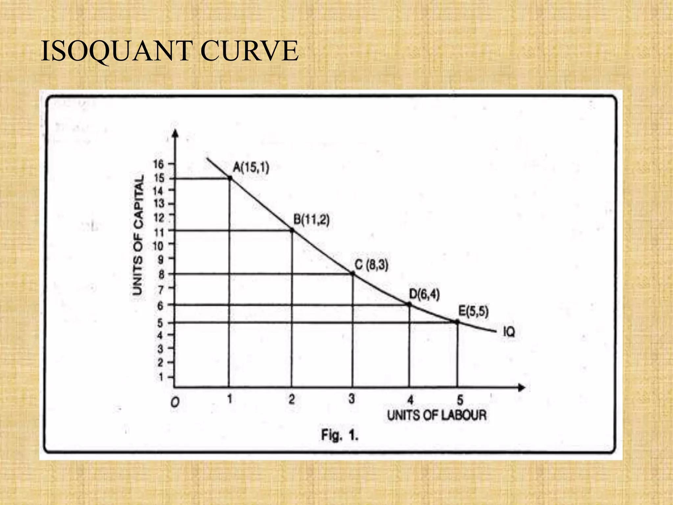

Slide 19
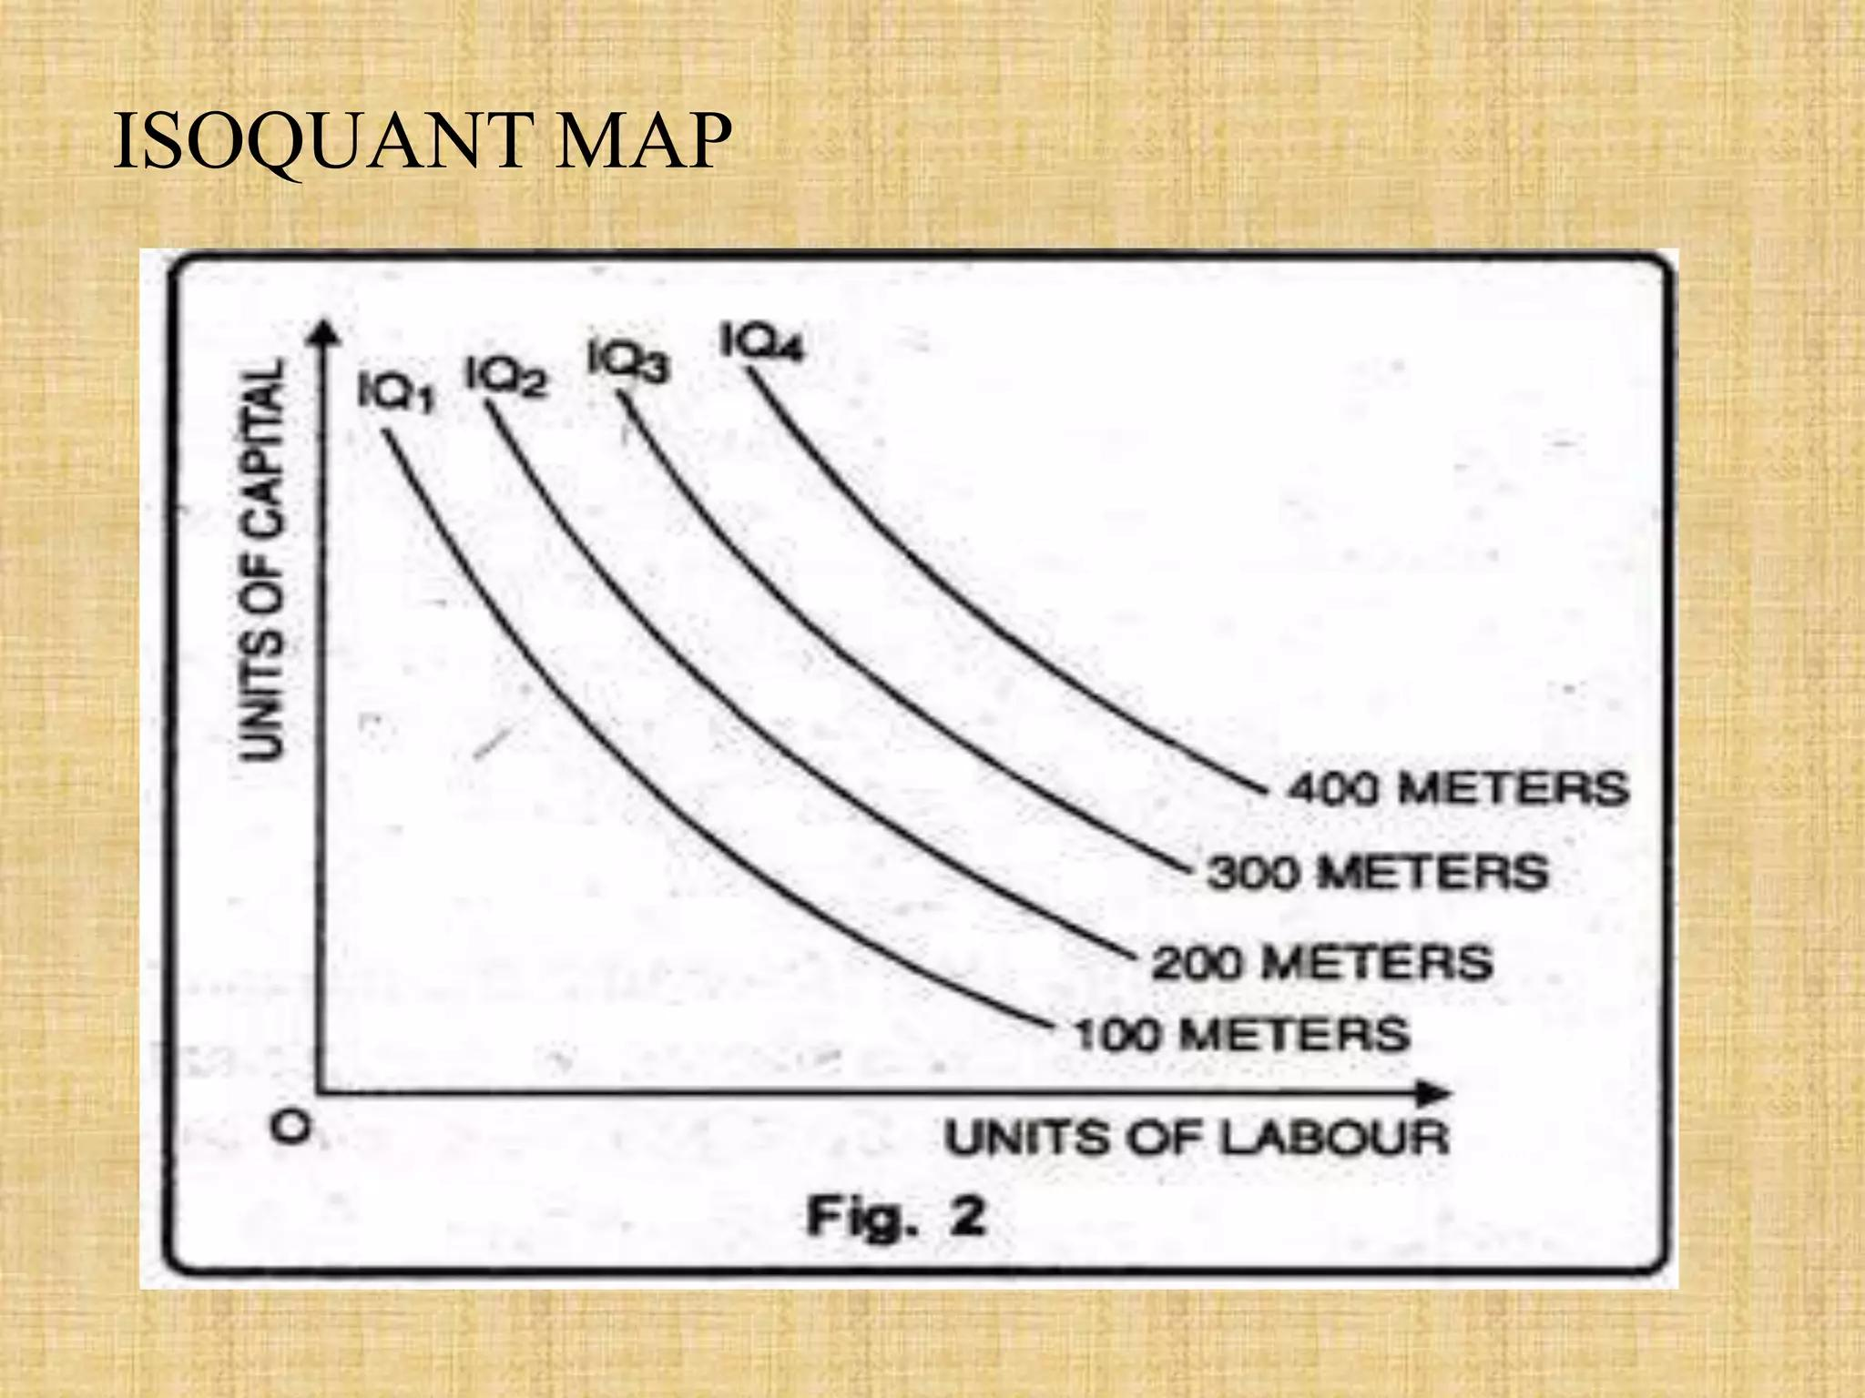

Slide 20
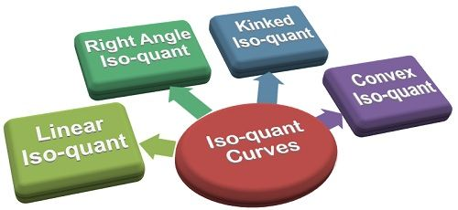
Notes:
Give example of small firm expanding to large factory and consequences on production efficiency.

Slide 21
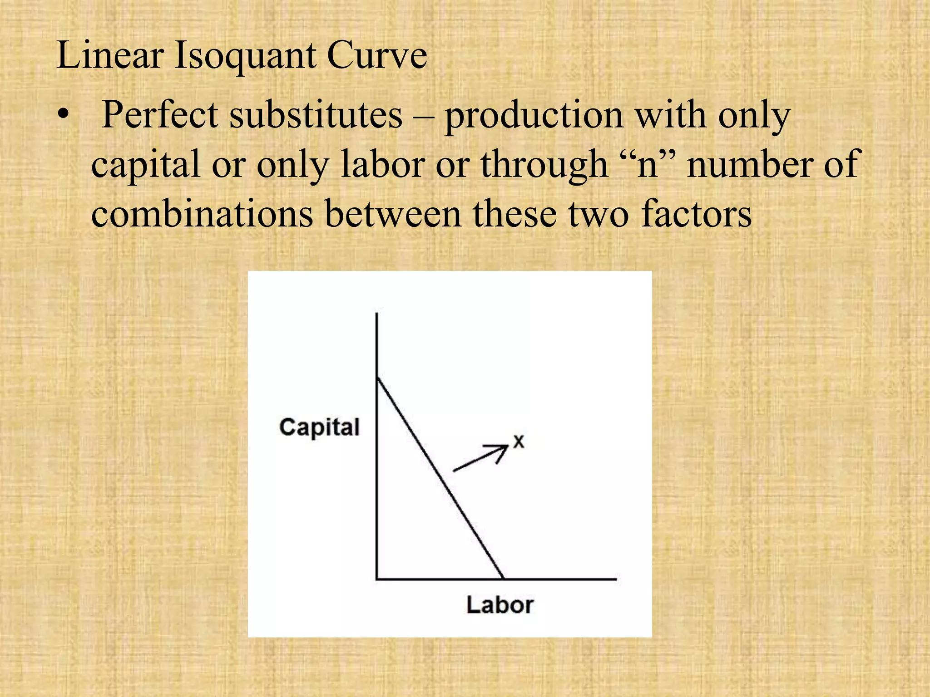
Notes:
Use this only as conceptual bridge to move towards producer behaviour.

Slide 22
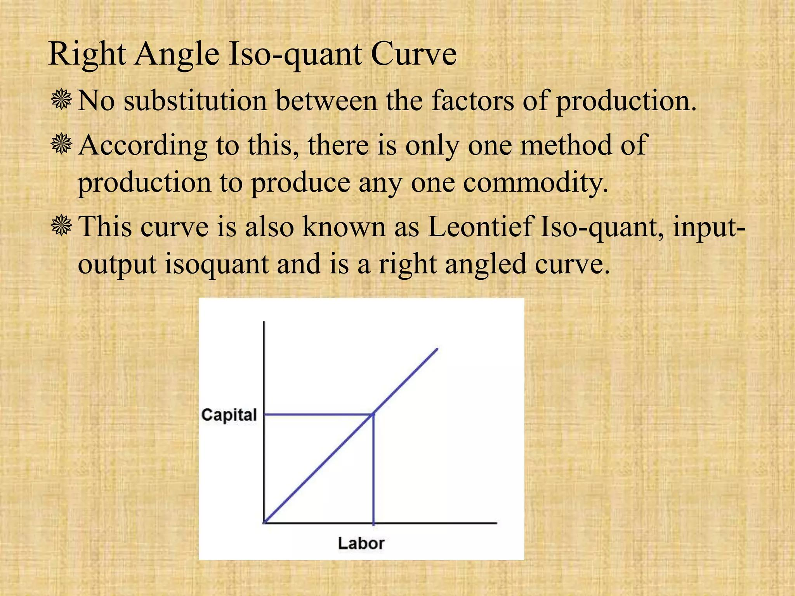

Slide 23
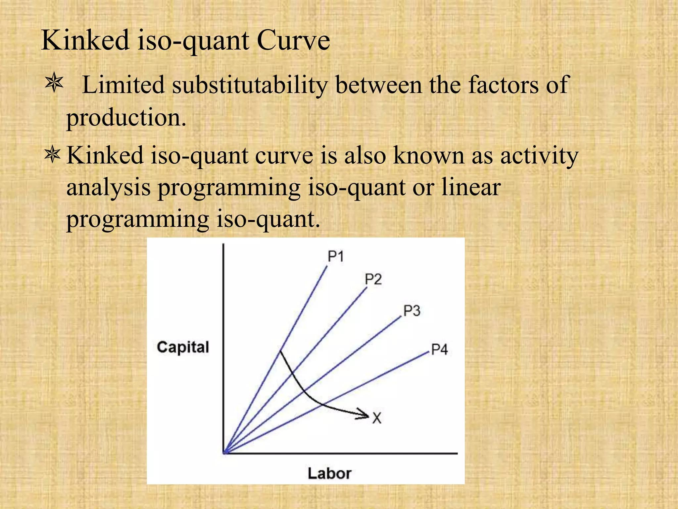

Slide 24
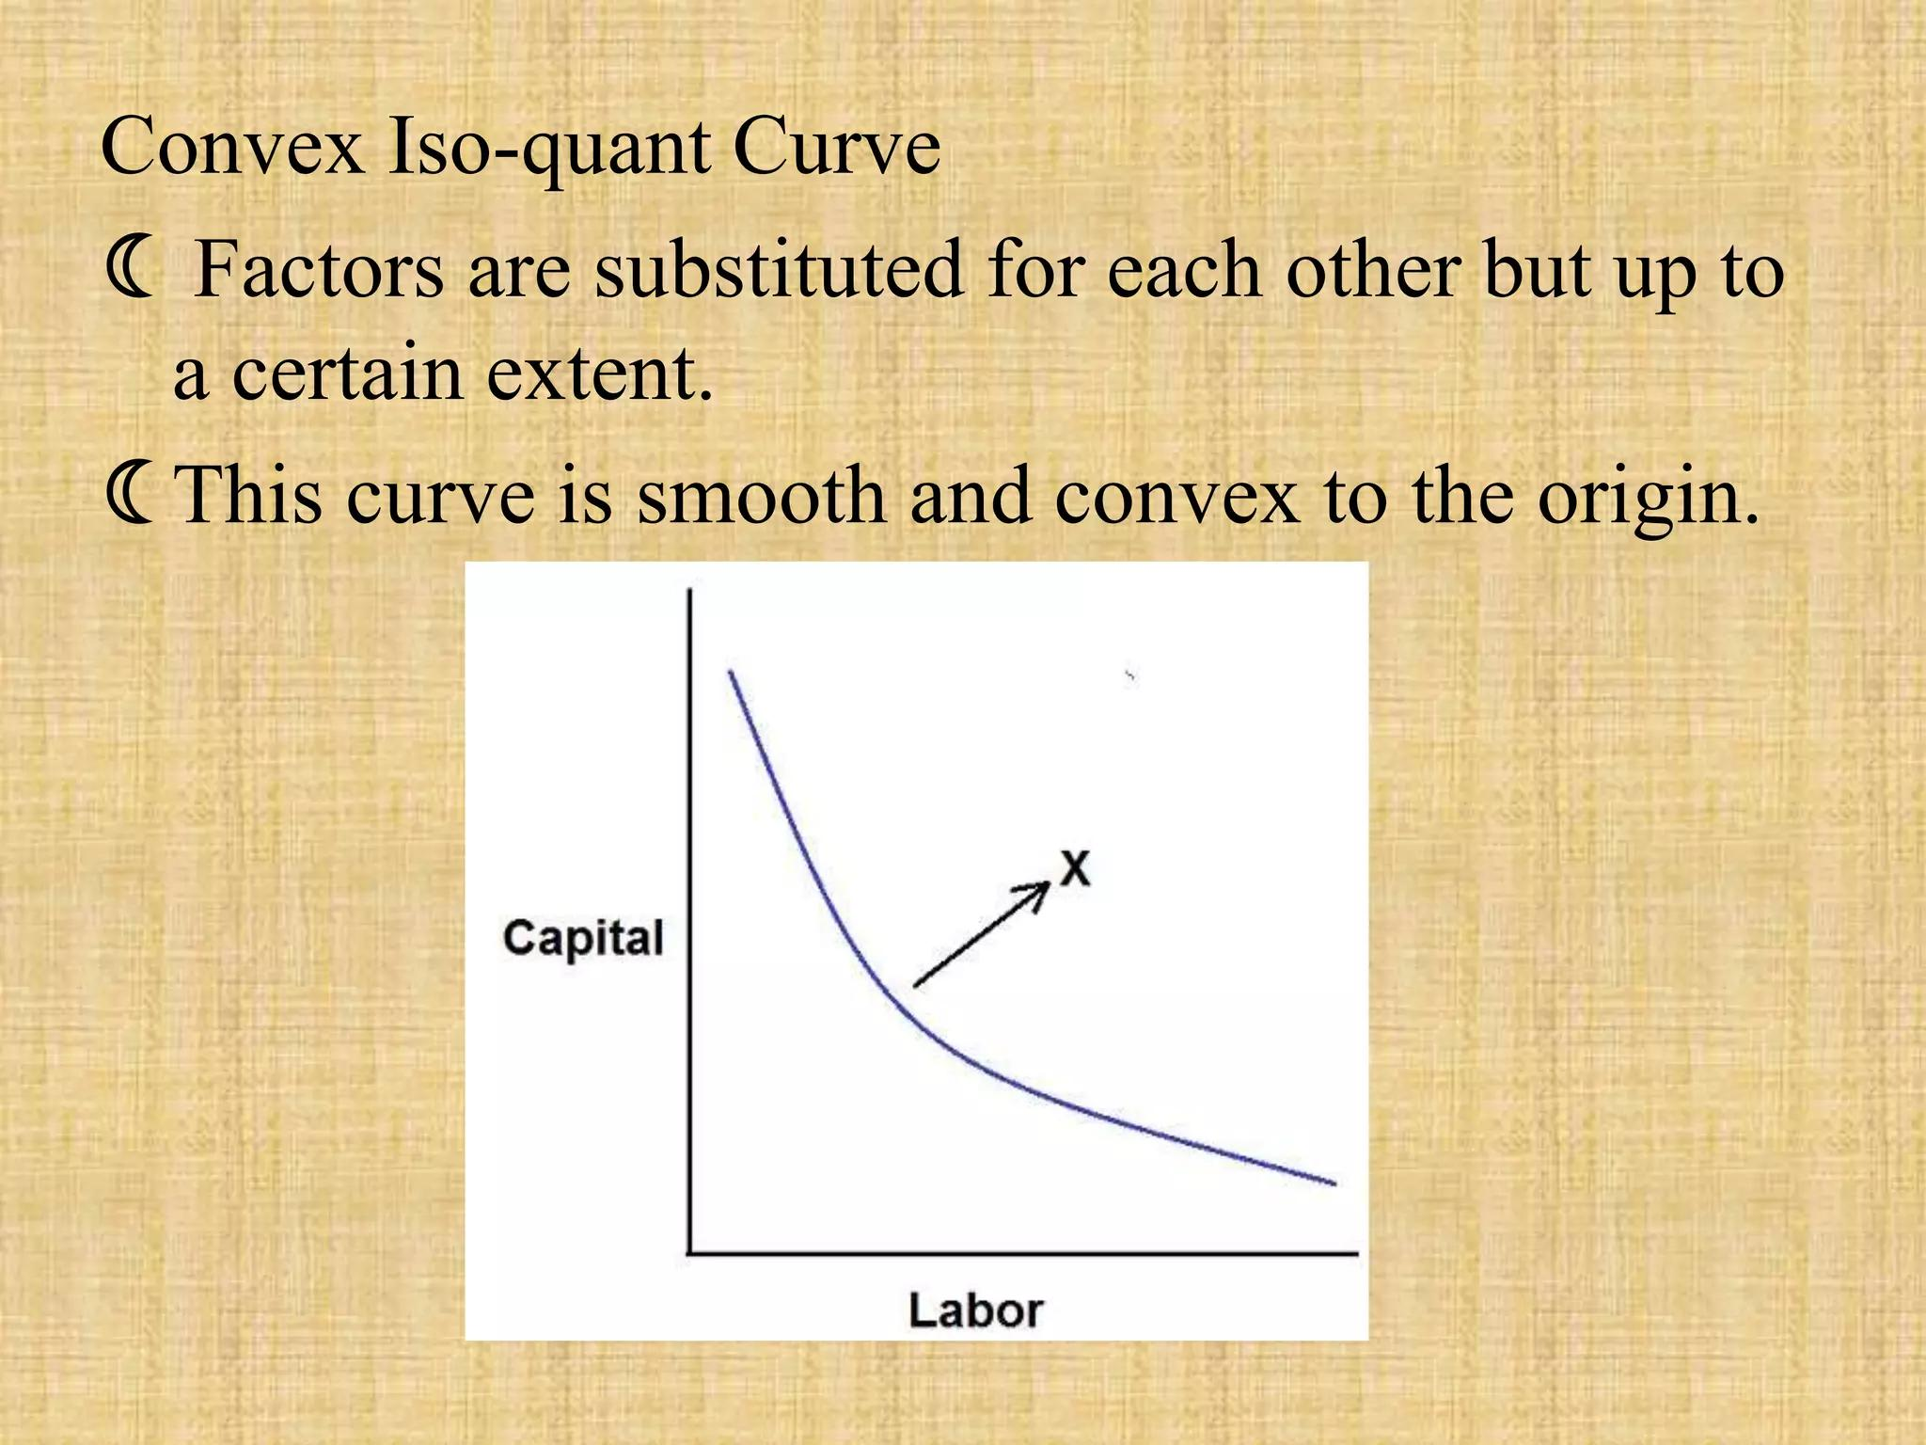

Slide 25
Iso-Cost
The term "isocost" literally means "equal cost." An isocost line represents all combinations of inputs (typically labor and capital) that a firm can use for a given total cost. Therefore, every point on a specific isocost line represents the same total cost of production.
C = wL + rK
Where:
C = Total Cost
w = Wage rate (price of labor)
L = Quantity of Labor
r = Rental rate of capital (price of capital)
K = Quantity of Capital
Notes:
Explain wage cost, capital cost and firm's financial limitation in choosing inputs.

Slide 26
ECONOMIES OF SCALE
Economies of scale refer to the cost advantages that a business can achieve due to increased production. As a company produces more goods or services, its average cost per unit tends to decrease. This reduction in average cost arises from various factors that make large-scale production more efficient. The concept “economies of scale” may be viewed in two senses: broad and narrow.
Definition: In a broad sense, anything which serves to minimize average cost of production in the long-run as the scale of output increases is referred to as “economies of scale.” It is measured in money terms.
The economies of scale may be classified as:
Internal economies
External economies

Slide 27
Internal Economies: Internal economies are those economies which are open to an individual firm when its size expands. They emerge within the firm itself as its scale of production increases. Internal economies in the scale of its output cannot be realized unless the firm increases its output, i.e., expands its size. Thus, internal economies are the function of the size of a firm. These are solely enjoyable by the firm itself when its scale of production increases, independently of the actions of other firms.
External Economies: External economies are those economies which are shared by all the firms in an industry or in a group of industries when their size expands. They are available to all firms from outside, irrespective of their size and scale of production. They are the result of the growth and expansion of any particular industry or a group of industries as a whole. Thus, external economies are the function of the size of the industry. They are not confined to one or two firms, but shared by all the firms (irrespective of their size) in an industry when its size expands.

Slide 28
Forms of Internal Economies:
Labour economies
Technical Economies
Managerial Economies
Marketing Economies
Financial Economies
Risk-Minimising Economies
Forms of External conomies:
Economies of Localisation
Economies of Information or Technical and Market Intelligence
Economies of Vertical Disintegration
Economies of By-products

Slide 29
Impact of Economies of Scale:
Lower Production Costs: Economies of scale lead to lower per-unit production costs, which can translate into lower prices for consumers and higher profits for firms.
Increased Efficiency: By using more efficient production techniques and specialized labor, firms can increase their overall efficiency and productivity.
Competitive Advantage: Firms that can achieve economies of scale have a competitive advantage over smaller firms that cannot. This allows them to capture a larger market share and generate higher profits.
Market Concentration: Economies of scale can lead to market concentration, where a few large firms dominate the industry. This can reduce competition and potentially lead to higher prices for consumers.
Innovation: The increased profitability resulting from economies of scale can allow firms to invest more in research and development, leading to innovation and new products.

Slide 30
Diseconomies OF SCALE
While economies of scale offer significant advantages, there is a point at which further expansion can lead to diseconomies of scale. Diseconomies of scale occur when a firm becomes too large and complex to manage effectively, leading to increased costs and reduced efficiency.
The following factors of diseconomies of scale limit the size of a firm:
Difficulties of Management
Difficulties of Coordination
Difficulties in Decision-making
Increased Risks
Labour Diseconomies
Scarcity of Factor Supplies
Financial Difficulties
Marketing Diseconomies

Slide 31
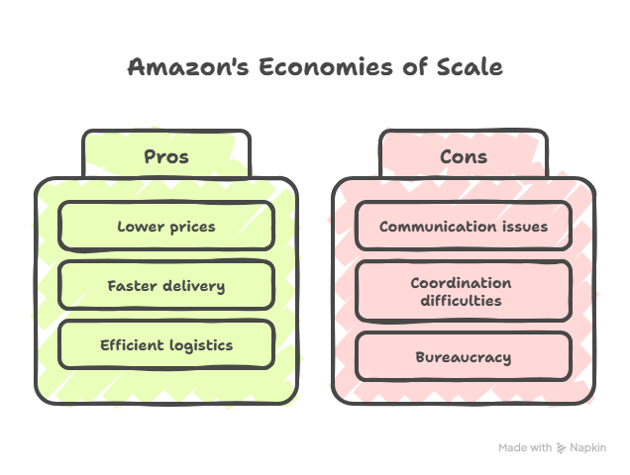
Notes:
Explain that very large firms may become difficult to manage leading to higher costs.

Slide 32
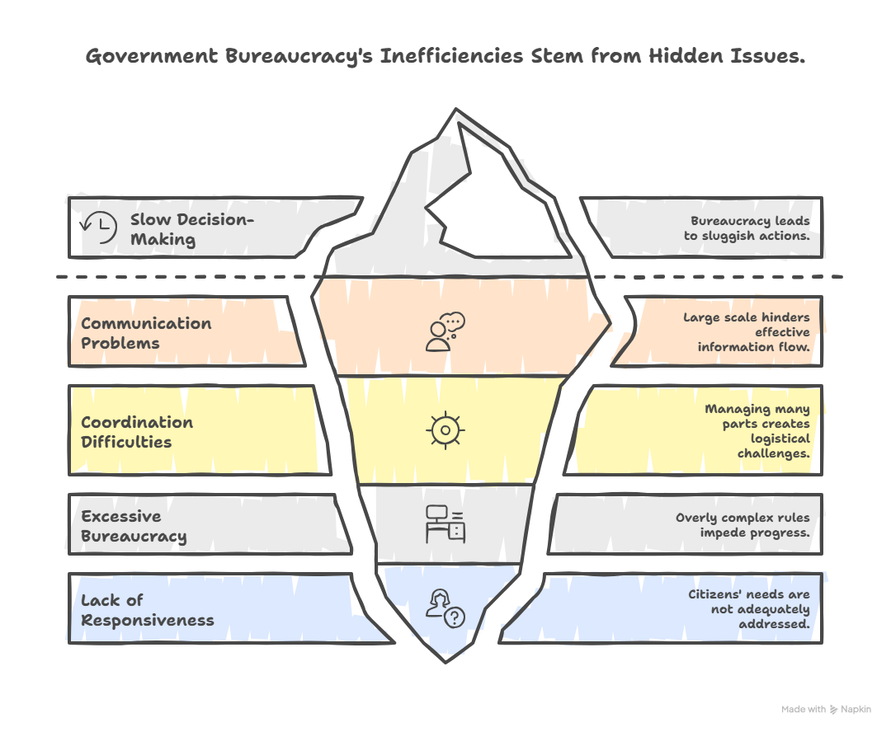

Slide 33

COST

Slide 34
In managerial economics, cost is normally considered from the producer’s or firm’s point of view. In producing a commodity (or service), a firm has to employ an aggregate of various factors of production such as land, labour, capital and entrepreneurship. These factors are to be compensated by the firm for their efforts or contribution made in producing the commodity. The cost of production of a commodity is the aggregate of price paid for the factors of production used in producing that commodity. Cost of production, therefore, denotes the value of the factors of production employed. In short, thus, the value of inputs required in the production of a good determines its cost of output. The term “cost” has various concepts.
These are: (i) Real Cost; (ii) Opportunity Cost; and (iii) Money Cost.
Real cost: The real cost of production of a commodity refers to the exertion of labour, sacrifice involved in the abstinence from present consumption by the savers to supply capital, and social effects of pollution, congestion, and environmental distortions.
Notes:
Give examples: rent, insurance (fixed); raw materials (variable); electricity partly fixed partly variable.

Slide 35
Real cost, thus, signifies the Aggregate of real productive resources absorbed in the production of a commodity (or a Service). In a much philosophical way, Marshall (1920), describes “real cost” as follows: “The production of a commodity generally requires many different kinds of labour and the use of capital in many forms. The exertions of all the different kinds of labour that are directly or indirectly involved in making it together with the abstinences or rather the waiting required for saving the capital used in making it, all these efforts and sacrifices together will be called the real cost of production of commodity.”
OPPORTUNITY COST OR ALTERNATIVE COST: Since the real production cost cannot be measured in an absolute sense, the concept of opportunity cost is evolved to measure it in an objective sense. The concept of opportunity cost is based on the scarcity and versatility (alternative applicabilities) characteristics of productive resources. It is the most fundamental concept in economics.
Notes:
Explain law of diminishing returns influence on cost shapes.

Slide 36

“The alternative or opportunity cost of one unit of product A is the amount of product B that has been sacrificed by allocating the resources to produce A rather than B.”
MONEY COST: “Money cost” is the monetary expenditure on inputs of various kinds raw materials, labour, etc., required for the output. It is the money spent on purchasing the different units of factors of production needed for producing a commodity. Money cost is, obviously the payment made for the factors in terms of money. Money cost is the outlay cost, i.e., actual financial expenditure of the firm.
Notes:
Explain economies of scale reduce cost then diseconomies increase it leading to U shape.

Slide 37
Explicit and Implicit Costs: Explicit costs are direct contractual monetary payments incurred through market transactions. Implicit costs are the opportunity costs of the use of factors which a firm does not buy or hire but already owns.
The following items of a firm’s expenditure are explicit money costs:
Costs of raw materials;
Wages and salaries;
Power charges;
Rent of business or factory premises;
Interest payments of capital invested;
Insurance premiums;
Taxes like property tax, duties, license fees, etc.;
Miscellaneous business expenses like marketing and advertising expenses (selling costs), transport cost, etc.
Notes:
Explain importance in business planning, survival planning, cost control and pricing decisions.

Slide 38
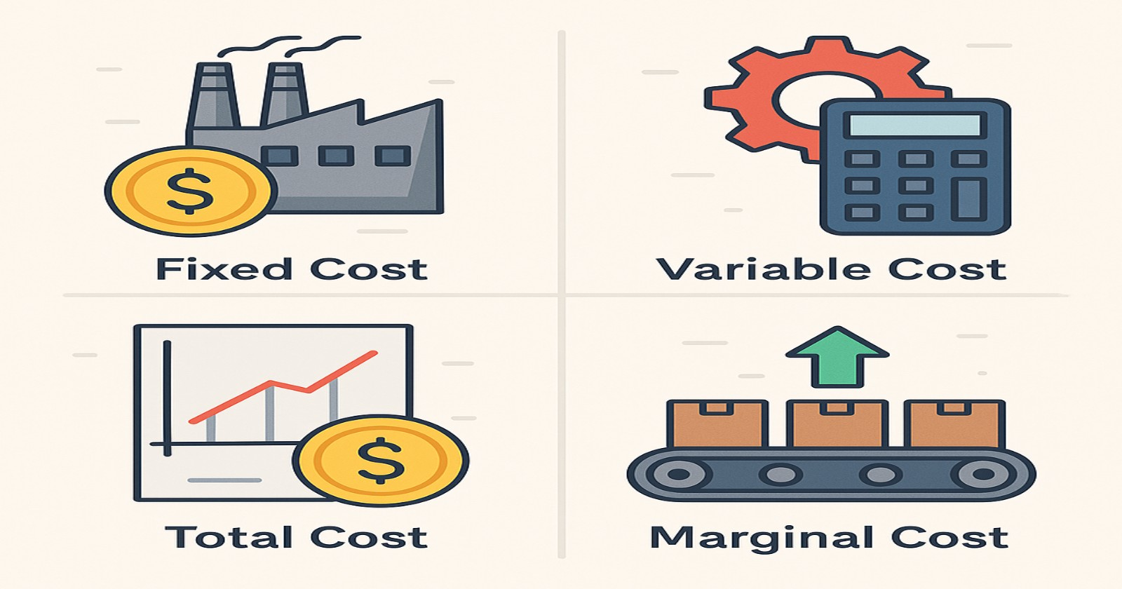
Thus, implicit money costs are as follows:
Wages of labour rendered by the entrepreneur himself.
Interest on capital supplied by him.
Rent of land and premises belonging to the entrepreneur himself and used in his production.
Normal returns (profits) of entrepreneur, a compensation needed for his management and organisational activity.
Notes:
Explain contribution meaning as amount available to cover fixed costs and profit.

Slide 39
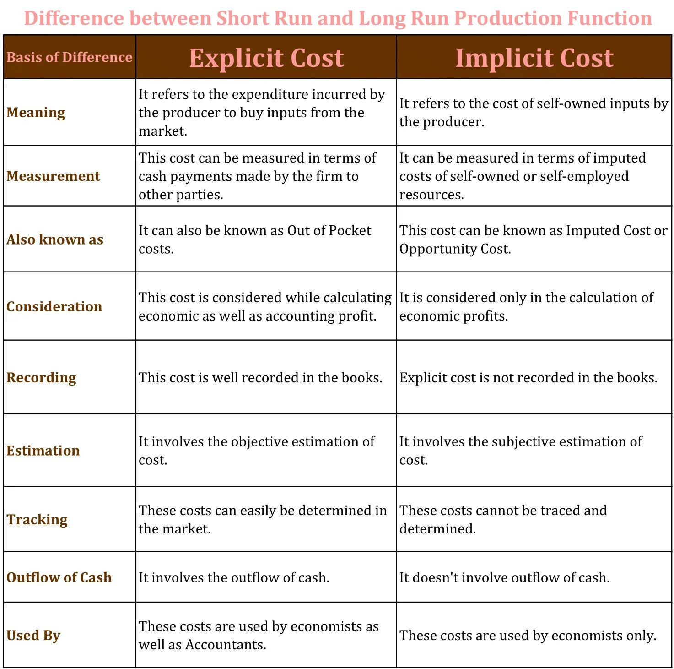

Slide 40
Fixed Costs: Fixed costs are the amount spent by the firm on fixed inputs in the short-run. Fixed costs are, thus, those costs which remain constant, irrespective of the level of output. These costs remain unchanged even if the output of the firm is nil. Fixed costs, therefore, are known as “supplementary costs” or “overhead costs.” Fixed costs, in the short-run, remain fixed because the firm does not change its size and amount of fixed factors employed. Fixed or supplementary costs usually include:
Payments of rent for building.
Interest paid on capital.
Insurance premiums.
Depreciation and maintenance allowances.
Administrative expenses: salaries of managerial and office staff, etc.
Property and business taxes, licence fees, etc.
Notes:
Explain working step by step and managerial interpretation.

Slide 41
Variable Costs: Variable costs are those costs that are incurred on variable factors. These costs vary directly with the level of output. In other words, variable costs are those costs which rise when output expands and fall when output contracts. When output is nil, they are reduced to zero. Variable costs are frequently referred to as direct costs or prime costs. Briefly, variable costs or prime costs represent all those costs which can be altered in the short-run as the output alters. These are regarded as “avoidable contractual costs” (when output is nil). The short-run variable costs include:
Prices of raw materials,
Wages of labour,
Fuel and power charges,
Excise duties, sales tax,
Transport expenditure, etc.
Notes:
Explain higher MOS means safer business position.

Slide 42
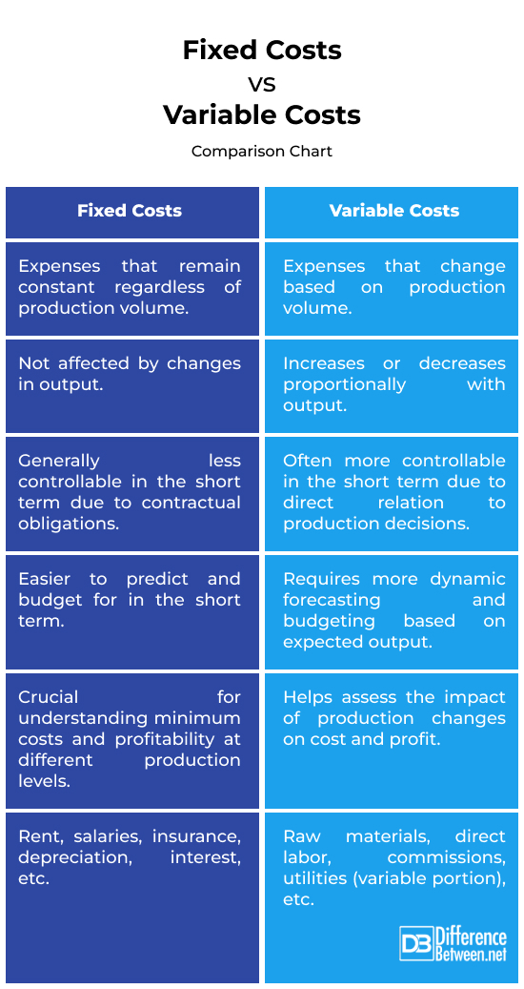

Slide 43
TYPES OF PRODUCTION COSTS AND THEIR MEASUREMENT: In economic analysis, the following types of costs are considered in studying cost data of a firm:
Total cost (TC), (TC = TFC + TVC)
Total fixed cost (TFC),
Total variable cost (TVC),
Average fixed cost (AFC), AFC=TFC/Q
Average variable cost (AVC), AVC=TVC/Q
Average total cost (ATC), ATC or AC= TC/Q (ATC = AFC + AVC.)
Marginal Cost (MC): Marginal cost is the cost of producing an extra unit of output. In other words, marginal cost may be defined as the change in total cost associated with a one unit change in output. It is also an “extra-unit cost” or incremental cost, as it measures the amount by which total cost increases when output is expanded by one unit. It can also be calculated by dividing the change in total cost by the one unit change in output.
Notes:
Explain managers use BEA before taking strategic business decisions.

Slide 44
Break Even Analysis
The break-even analysis (BEA) has considerable significance for economic research, business decision-making, company management, investment analysis and public policy. The BEA is an important technique to trace the relationship between costs, revenue and profits at the varying levels of output or sales.
Break-even analysis is a financial calculation that determines the point at which a company's total revenue equals its total costs. At the break-even point, the company is neither making a profit nor incurring a loss. It's a critical tool for businesses of all sizes, helping them understand the relationship between costs, volume, and profit.
Notes:
Recap key learning points in class before ending.

Slide 45
Assumptions of Break-Even Analysis:
The validity of the BEA is conditioned by a number of assumptions as follows:
1. The cost function and the revenue function are linear.
2. The total cost is divided into fixed and variable costs.
3. The selling price is constant.
4. The volume of sales and the volume of production are identical.
5. Average and marginal productivity of factors are constant.
6. The product-mix is stable in the case of a multi-product firm.
7. Factor price is constant.
Notes:
Encourage students to discuss application of theory in real business situations.

Slide 46
Limitations of Break-Even Analysis:
It is static: In the BEA, everything is assumed to be constant. This implies a static condition. It is not suited to a dynamic situation.\
It is unrealistic: It is based on many assumptions which do not hold good in practice. Linearity of cost and revenue function are true only for a limited range of output.
It has many shortcomings: The BEA regards profit as a function of output only. It fails to consider the impact of technological change, better management, division of labour, improved productivity and such other factors influencing profits.
Its scope is limited to the short-run only: The SEA is not an effective tool for a long-run analysis.
It assumes horizontal demand curve with the given price of the product: But this is not so in the case of a monopoly firm.
It is difficult to handle selling costs in the BEA: Selling costs do not vary with output. They manipulate sales and affect the volume of output.
The traditional BEA is very simple: It makes no provision for corporate income-tax, etc.

Slide 47
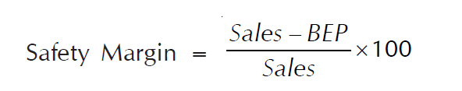
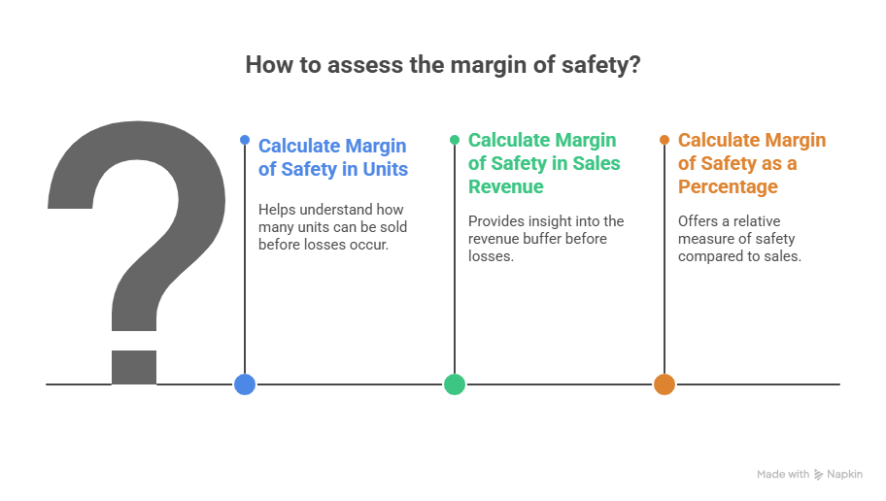
The BEA can be used for determining the ‘safety margin’ regarding the extent to which the firm can permit a decline in sales without causing losses.

Slide 48
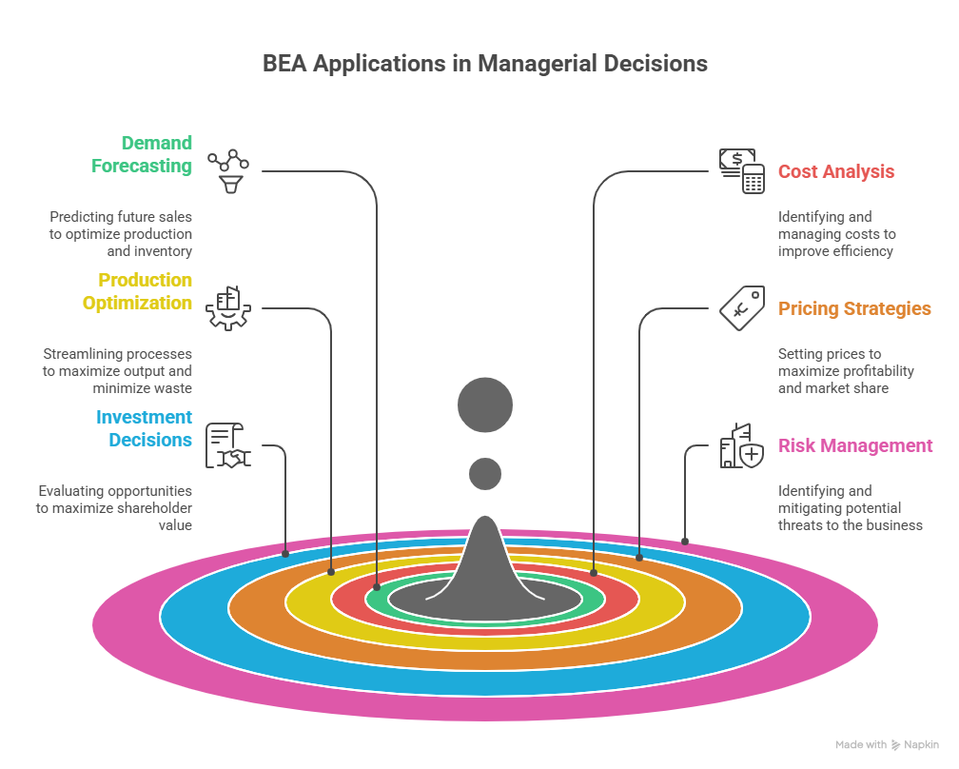

Slide 49


